Slide 1
Wired LANs: Ethernet
IEEE Standards
Standard Ethernet
Changes in the Standard
Fast Ethernet
Gigabit Ethernet

Slide 2

IEEE Standards
In 1985, the Computer Society of the IEEE started a project, called Project 802, to set standards to enable intercommunication among equipment from a variety of manufacturers. Project 802 is a way of specifying functions of the physical layer and the data link layer of major LAN protocols.

Slide 3
IEEE 802 Working Group
Active working groups | Inactive or disbanded working groups
802.1 Higher Layer LAN Protocols Working Group 802.3 Ethernet Working Group 802.11 Wireless LAN Working Group 802.15 Wireless Personal Area Network (WPAN) Working Group 802.16 Broadband Wireless Access Working Group 802.17 Resilient Packet Ring Working Group 802.18 Radio Regulatory TAG 802.19 Coexistence TAG 802.20 Mobile Broadband Wireless Access (MBWA) Working Group 802.21 Media Independent Handoff Working Group 802.22 Wireless Regional Area Networks | 802.2 Logical Link Control Working Group 802.4 Token Bus Working Group 802.5 Token Ring Working Group 802.7 Broadband Area Network Working Group 802.8 Fiber Optic TAG 802.9 Integrated Service LAN Working Group 802.10 Security Working Group 802.12 Demand Priority Working Group 802.14 Cable Modem Working Group

Slide 4
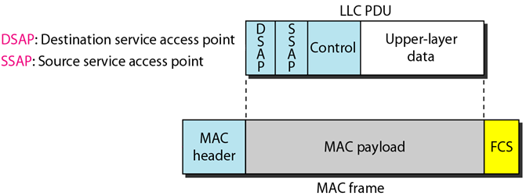
Data Link Layer
The data link layer in the IEEE standard is divided into two sublayers: LLC and MAC.
Flow control, error control, and part of the framing duties are collected into one sublayer called the LLC.
Framing is handled in both the LLC sublayer and the MAC sublayer.
Framing: LLC defines a protocol data unit (PDU) that is similar to that of HDLC. Control field is used for flow and error control. The two other header fields define the upper-layer protocol at the source and destination that uses LLC.
In contrast to the LLC sublayer, the MAC sublayer contains a number of distinct modules; each defines the access method and the framing format specific to the corresponding LAN protocol.
The physical layer is dependent on the implementation and type of physical media used.
LLC and MAC frames

Slide 5

Standard Ethernet
The original Ethernet was created in 1976 at Xerox’s Palo Alto Research Center (PARC). Since then, it has gone through four generations: Standard Ethernet (10 Mbps), Fast Ethernet (100 Mbps), Gigabit Ethernet (1 Gbps), and Ten-Gigabit Ethernet (10 Gbps).

Slide 6

Standard Ethernet - MAC Sublayer
Governs the operation of the access method, frames the data received from the upper layer and passes them to the physical layer.
Frame Format
Preamble: alerting the receiving system to the coming frame and enabling it to synchronize its input timing.
SFD: signals the beginning of the frame. Last 2 bits is 11 and alerts the receiver that the next field is the destination address.
Length or type: type field to define the upper-layer protocol or length field to define the number of bytes in the data field.
CRC: CRC-32

Slide 7


Ethernet has imposed restrictions on both the minimum and maximum lengths of a frame, as shown in fig.
Each station on an Ethernet network (such as a PC, workstation, or printer) has its own network interface card (NIC). The Ethernet address is 6 bytes, normally written in hexadecimal notation, with a colon between the bytes.

Slide 8

A source address is always a unicast address. The destination address, can be unicast, multicast or broadcast. The least significant bit of the first byte defines the type of address. If the bit is 0, the address is unicast; otherwise, it is multicast. The broadcast destination address is a special case of the multicast address in which all bits are 1s.
Access method: 1-persistent CSMA/CD
Slot time = rount-trip time + time required to send the jam sequence
  512 bits for Ethernet, 51.2 μs for standard (10 Mbps) Ethernet
Slot time and maximum network length
  MaxLength = PropagationSpeed x SlotTime/2 = (2x10⁸) x (51.2x10⁻⁶/2) = 5120 m
  MaxLength = 2500 m, just 48% of the theoretical calculation by considering delay times in repeaters and interfaces, and the time required to send the jam sequence.

Slide 9

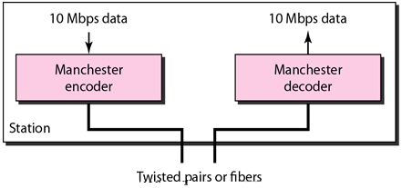
Standard Ethernet – Physical Layer
The Standard Ethernet defines several physical layer implementations; four of the most common are shown in fig.
All implementations use digital signaling (baseband) at 10Mbps. At the sender, data are converted to a digital signal using the Manchester scheme; at the receiver, the received signal is interpreted as Manchester and decoded into data.

Slide 10
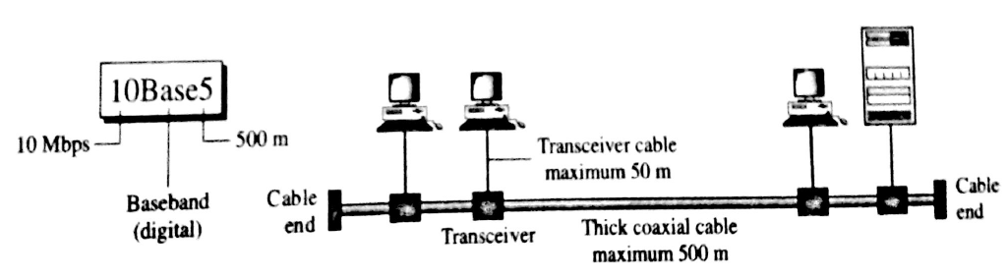
10Base5: Thick Ethernet
Also called Thicknet, the nick-name derives from the size of the cable, and it is too stiff to bend with the hands.
Use a bus topology with an external transceiver (transmitter/receiver) connected via a tap to a thick coaxial cable.
Transceiver is responsible for transmitting, receiving, and detecting collisions. The transceiver is connected to the station via a transceiver cable that provides separate paths for sending and receiving.
Note that collision can only happen in the coaxial cable.
Maximum length of the coaxial cable must not exceed 500m, otherwise, there is excessive degradation of the signal.
Using repeaters length can be extended.

Slide 11

10Base2: Thin Ethernet
Also called Cheapernet.
It also uses a bus topology, but the cable is much thinner and more flexible. The cable can be bent to pass very close to the stations.
Transceiver is normally part of the network interface card (NIC), which is installed inside the station.
It is more cost effective than 10Base5 because thin coaxial cable is less expensive than thick coaxial and the T-connections are much cheaper than taps.
Installation is simpler.
However, the length of each segment cannot exceed 185m (close to 200m) due to the high level of attenuation in thin coaxial cable.

Slide 12

10BaseT: Twisted-Pair Ethernet
It uses a physical star topology. The stations are connected to a hub via two pairs of twisted cable.
Note that two pairs of twisted cable create two paths (one for sending and one for receiving) between the station and the hub.
Any collision here happens in the hub.
The maximum length of the twisted cable here is defined as 100m, to minimize the effect of attenuation in the twisted cable.

Slide 13

10Base-F: Fiber Ethernet
It uses a star topology to connect stations to a hub. The stations are connected to the hub using two fiber-optic cables.

Slide 14

Summary of Standard Ethernet

Slide 15


Changes in the Standard
The10-Mbps Standard Ethernet has gone through several changes before moving to the higher data rates.
Bridged Ethernet: Raising bandwidth and separating collision domains.
- A bridge divides the network into two or more networks. Bandwidth- wise, each network is independent.
A network with and without a bridge
Collision domains in an unbridged network and a bridged network

Slide 16

Switched Ethernet:
The idea of a bridged LAN can be extended to a switched LAN. Instead of having two to four networks, why not have N networks, where N is the number of stations on the LAN?
A layer 2 switch is an N-port bridge with additional sophistication that allows faster handling of the packets.
In this way, the bandwidth is shared only between the station and the switch (5Mbps each). In addition, the collision domain is divided into N domains.

Slide 17

Full-Duplex Ethernet:
The full-duplex mode increases the capacity of each domain from 10 to 20Mbps.
Note that instead of using one link between the station and the switch, the configuration uses two links: one to transmit and one to receive.
There is no need for the CSMA/CD method.
To provide flow and error control, a new sublayer, called the MAC control, is added between the LLC and the MAC sublayers.

Slide 18
Fast Ethernet
Under the name of IEEE 802.3u
  Data rates of 100 Mbps.
  Is backward-compatible with Standard Ethernet.
  Same 48-bit address and the frame format of Standard Ethernet.
  Same min. and max. frame length of Standard Ethernet.
MAC Sublayer
  Only the star topology, there are two choices: half duplex and full duplex.
  In the half-duplex approach, the stations are connected via a hub; in the full-duplex approach, the connection is made via a switch with buffers at each port.
  Access method is CSMA/CD for the half-duplex approach; No need for for full-duplex Fast Ethernet.
  A new feature, called autonegotiation is added which allows two devices to negotiate the mode or data rate of operation.
  - Allows incompatible devices to connect to one another.
  - Allows one device to have multiple capabilities.
  - Allows a station to check a hub’s capabilities.

Slide 19


Fast Ethernet: Physical Layer
The physical layer in Fast Ethernet is more complicated than the one in Standard Ethernet.
Supports both point-to-point and multipoint. Three or more stations need to be connected in a star topology with a hub or a switch at the center.
Fast Ethernet implementations

Slide 20
100Base-TX:
Uses two pairs of twisted-pair cable.
MLT-3 scheme was selected since it has good bandwidth performance. However, since MLT-3 is not a self-synchronous line coding scheme, 4B/5B block coding is used.
100Base-FX:
Uses two pairs of fiber-optic cables.
Optical fiber can easily handle high bandwidth requirements by using simple encoding schemes. So, the NRZ-I encoding scheme is used for this implementation. However, NRZ-I has a bit synchronization problem. To overcome this problem, the designers used 4B/5B block encoding.
100Base-T4:
For buildings that have already been wired for voice-grade twisted-pair (CAT 3), a standard, called 100Base-T4, is designed.
Uses four pairs of UTP for transmitting 100Mbps.
One pair switches between sending and receiving and three pairs of UTP, however, handle 75Mbaud (25Mbaud each).
8B/6T, eight data elements are encoded as six signal elements. This means that 100Mbps uses only (6/8)x100Mbps, or 75Mbaud.

Slide 21

Fast Ethernet: Encoding

Slide 22
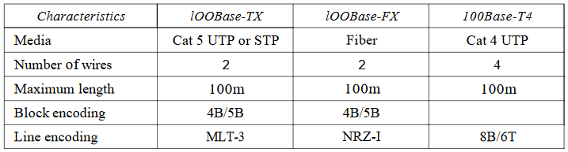
Summary of Fast Ethernet

Slide 23
Gigabit Ethernet
Under the name of IEEE Standard 802.3z.
  Data rates upto 1 Gbps.
  Backward-compatible with Standard or Fast Ethernet.
  Same 48-bit address and the frame format of Standard Ethernet.
  Same min. and max. frame length of Standard Ethernet.
  Support autonegotiation as defined in Fast Ethernet.
MAC Sublayer
  Two distinctive approaches for medium access: half-duplex and full-duplex.
  Most of all implementations follow full-duplex approach.
  In the full-duplex mode of Gigabit Ethernet, there is no collision; the maximum length of the cable is determined by the signal attenuation in the cable.
Half-duplex mode (very rare)
  Traditional: 512bits/1Gbps = 0.512 μs (max. length of the n/w is 25m)
  Carrier Extension: defines min. length of a frame as 512 bytes (4096 bits) so that max. length of the n/w is increased to 200m.
  Frame bursting to improve the inefficiency of carrier extension (in case of a series of short frames to send). Instead of adding an extension to each frame, multiple frames are sent. To make these multiple frames look like one frame, padding is added between the frames.

Slide 24


Gigabit Ethernet: Physical Layer
The physical layer in Gigabit Ethernet is more complicated than that in Standard or Fast Ethernet.
Supports both point-to-point and multipoint. Three or more stations need to be connected in a star topology with a hub or a switch at the center.
Another possible configuration is to connect several star topologies or let a star topology be part of another.
Gigabit Ethernet implementations

Slide 25
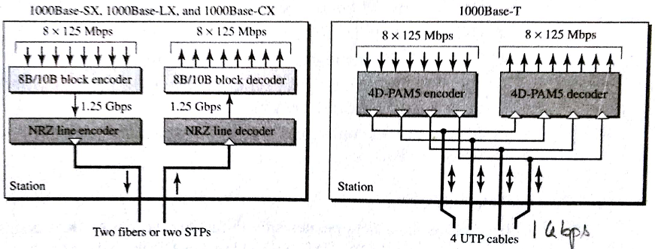
The two-wire implementations use an NRZ scheme, but NRZ does not self-synchronize properly. To synchronize bits, 8B/10B block encoding, is used.
Note that one wire (fiber or STP) is used for sending and one for receiving.
In the four-wire implementation, it is not possible to have 2 wires for input and 2 for output, because each wire would need to carry 500Mbps, which exceeds the capacity for category 5 UTP. As a solution, 4D-PAM5 encoding, is used to reduce the bandwidth. Thus, all four wires are involved in both input and output; each wire carries 250Mbps, which is in the range for category 5 UTP cable.

Slide 26
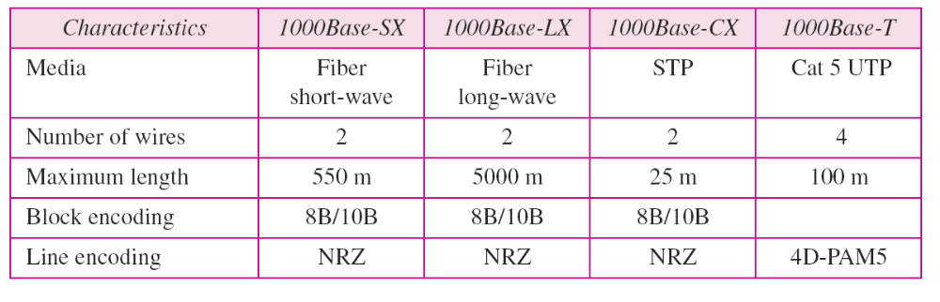
Gigabit Ethernet: Summary

